Slide 1
Internet Meme Guide
There is no barrier in cyber world

Slide 2
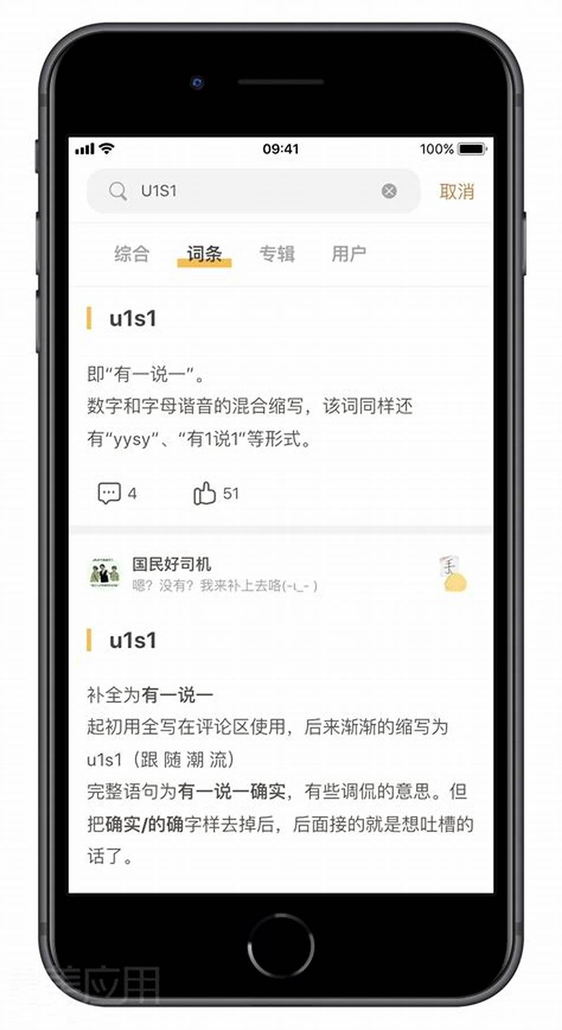
Design Prototype

Slide 3
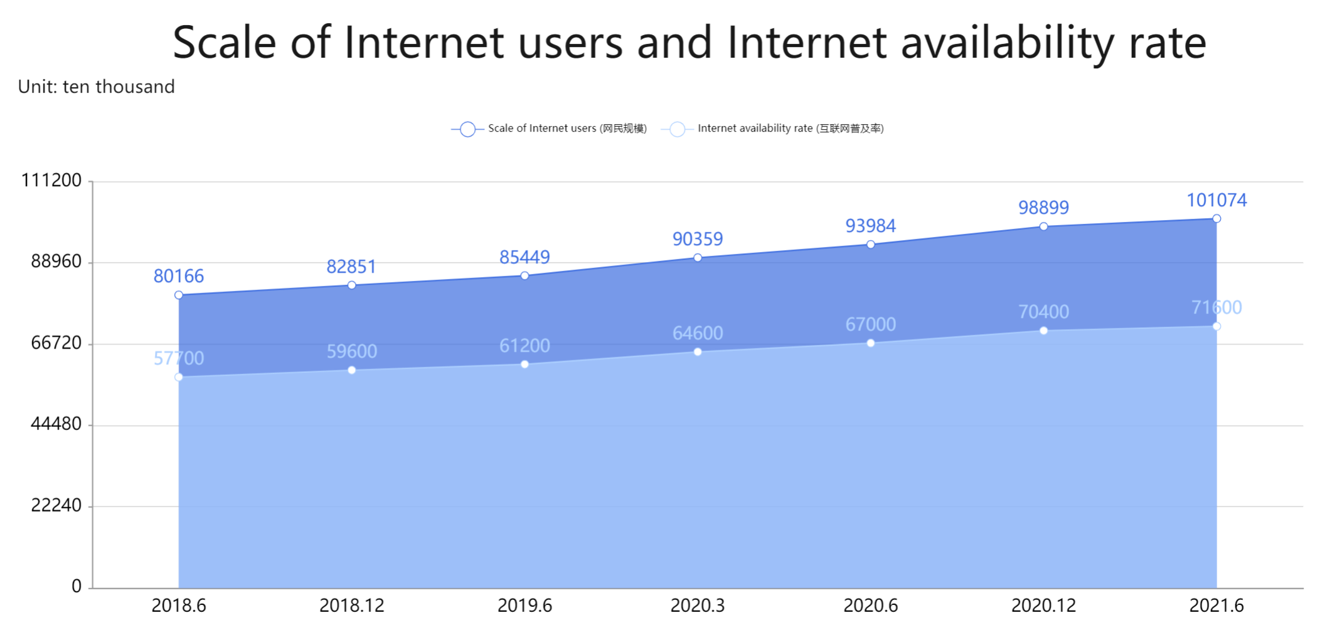
Why Meme Guide Is Needed?
Nearly 30% of people in China still know nothing about Internet
The scale of Internet users and Internet availability rate are still increasing, which means more and more “beginner” access Internet without any background knowledge
18.7% of China’s population is over 60 years old

Slide 4
Business Plan
01
02
03
04
Target user group
Sales Proposition
Marketing Channels
What kinds of people need this app most?
There is no barrier in cyber world!
How should we promote and advertise the app？
Financial Key Metrics for Mobile App Business Plan
How we make profit from it?

Slide 5
01
Target User Group
What kinds of people need this app most?

Slide 6
Target User Group
We hope this app can not only help the elderly adapt to the current Internet environment, shorten the information gap between the elderly and young people, make it easier for the elderly to integrate into the current society, but also provide young people a platform to share different memes, communicate and have fun together.

Slide 7
02
Sales Proposition
There is no barrier in cyber world!

Slide 8

Sales Proposition
Internet Meme Guide is a mobile app which helps users discover and share the most popular meme on the Internet. This app is designed for people who love humor, satire and want to stay up-to-date on the latest trends and memes

Slide 9
Sales Proposition
Curated content
User-generated content
Social features
Memes Guide features a carefully curated selection of the most popular and trendy memes on the Internet. Our team of content experts scours the web for the best and funniest memes and updates this app regularly with fresh content
In addition to curated content, Memes Guide allows users to create and share their own memes with their community. Users can submit their memes, vote for their favorites, and participate in meme challenges and contests
Memes Guide offers a range of social features, such as commenting, liking, and sharing memes with friends and followers

Slide 10
03
Marketing Channels
How should we promote and advertise the app？

Slide 11
Marketing Channels
Social Media
Influencer Marketing
Use platforms such as Weibo, Tieba and WeChat to share the meaning of funny memes meanwhile put ads, engage with users, and promote the app's features and content
Partner with popular social media influencers, meme creators, and content creators to promote the app and reach a wider audience
Search Engine Optimization
Public Relations
Optimize our app's website and app store listing with relevant keywords and content to improve our visibility in search results
Reach out to media outlets, bloggers, and journalists to feature our app in articles and reviews

Slide 12
04
Financial Key Metrics for Mobile App Business Plan

Slide 13
Financial Key Metrics for Mobile App Business Plan
The optimized app will be promoted to social groups based on user feedback within the school. Our goal is to reach 3000 users through various promotion channels within a month
Conservatively hope the revenue from ad can maintain the development and maintenance of the app
Alpha Version
Beta Version
Trail Version
RTM Version
GA Version
Be targeted at the campus user community, and we hope that the number of users on campus can reach 500
Maintain daily and monthly activity at 5000 and 15000
Better AD delivery algorithms, more investment on promotion

Slide 14
Log.d(“THANKS”)
Group Members: 廖若凡，罗丹，熊伟峰，陈子健

